Slide 1

What Is a Tumor? How Tumors Grow, Evolve, and Respond to Treatment
Hyunah Lim
Postdoctoral Associate
Institute for Health Computing

Slide 2
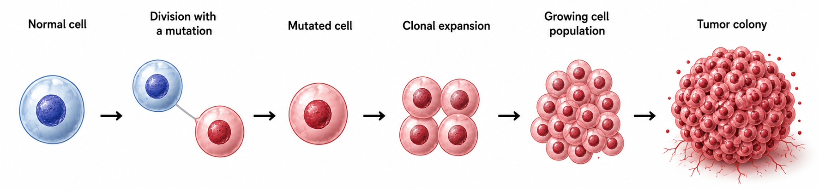
How Does a Tumor Begin?
Tumors begin with a mutation
Notes:
Solid tumors

Slide 3
From Tumor to Cancer
Benign Tumor
Malignant Tumor (Cancer)
Grows in a limited, contained mass
Does not invade nearby tissues
Often treatable by surgery
Invades surrounding tissues
Spreads to other parts of the body
Damages normal tissues and organ functions
Not every tumor is cancer,
but for any solid tumor, cancer begins as a tumor.
Notes:
Not every tumor is cancer, but every cancer begins as a tumor.

Slide 4
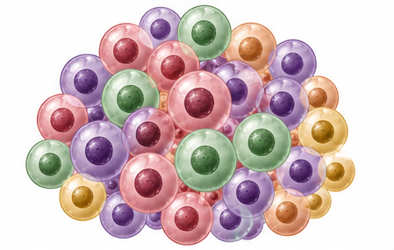
Diversity Within a Tumor
Different tumor cells can have different abilities:
Grow faster
Resist cell death
Resist treatments
Survive in harsh environments
Evade immune system
Mutations continue as a tumor grows.
There is no “typical” tumor cell.
Notes:
A tumor is an evolving population rather than a collection of identical cells.

Slide 5
Treating Cancer
Treatment | How it works | Limitation
Surgery | Remove tumor | Works for solid tumor only, Recurrence from the remainders
Chemotherapy | Kill rapidly dividing cells | Also kills healthy dividing cells, Drug resistance
Radiation therapy | Damage DNA with radiation | Sensitive to small changes, Radiation resistance
Immunotherapy | Activate the immune system | Immune-suppressive / evasive tumors
Targeted therapies | Targets specific pathways | Applicable only to a limited portion of tumor cells

Slide 6
What Makes a Tumor Difficult to Treat?
Every patient is different
Tumor heterogeneity
Treatment resistance
Changing tissue environment
Complex immune interactions
Doctors must decide treatment plan before knowing what will happen

Slide 7

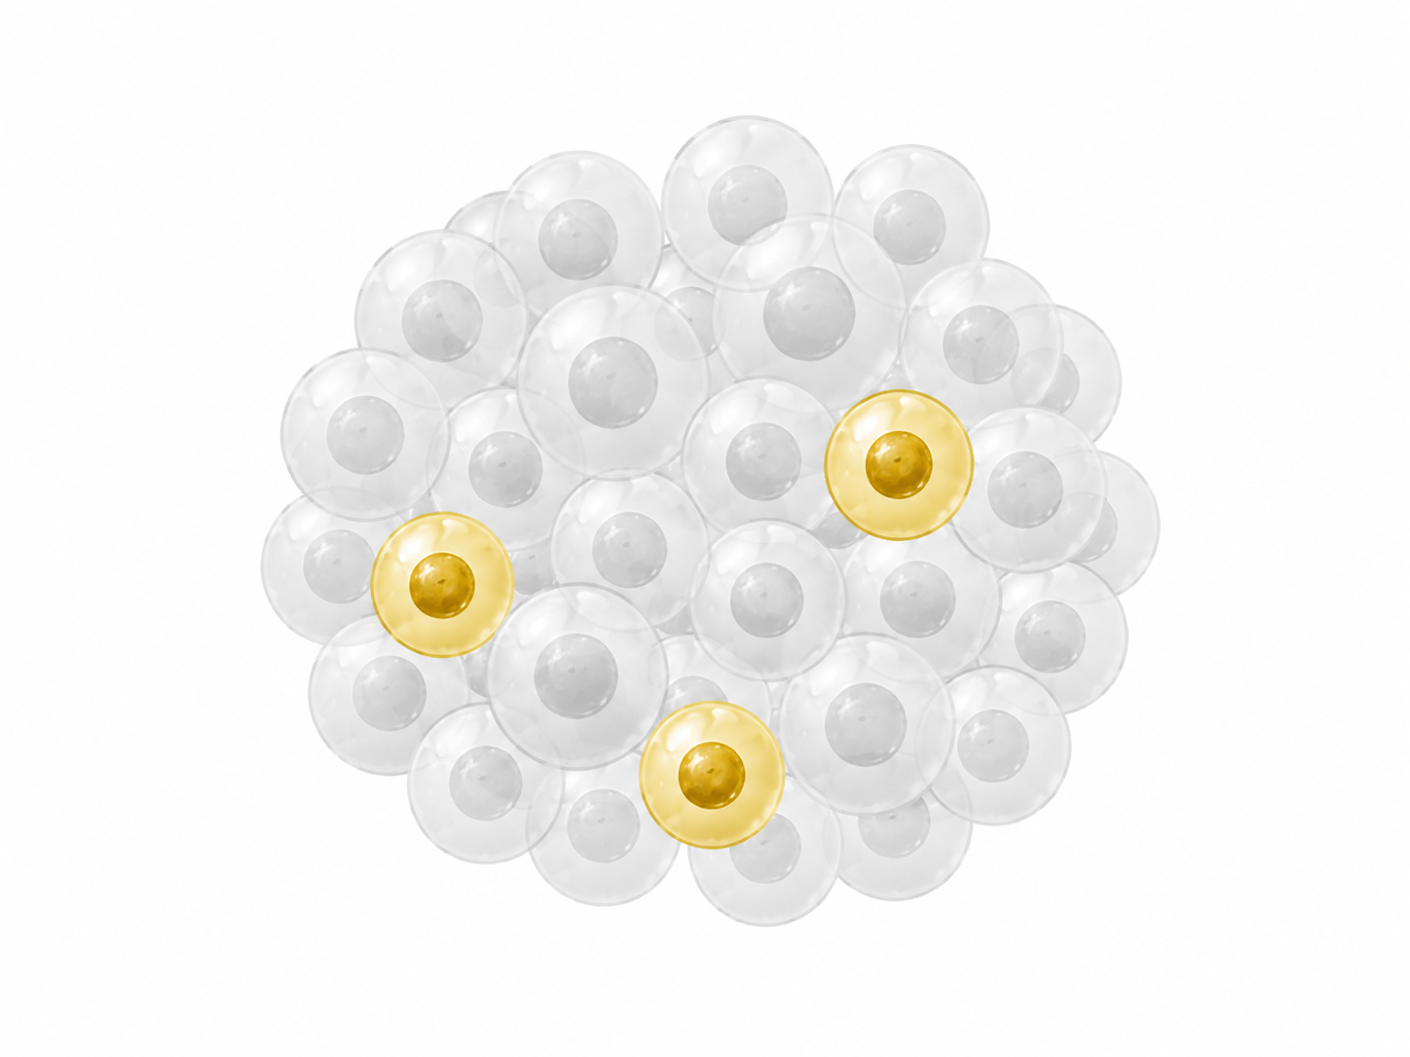
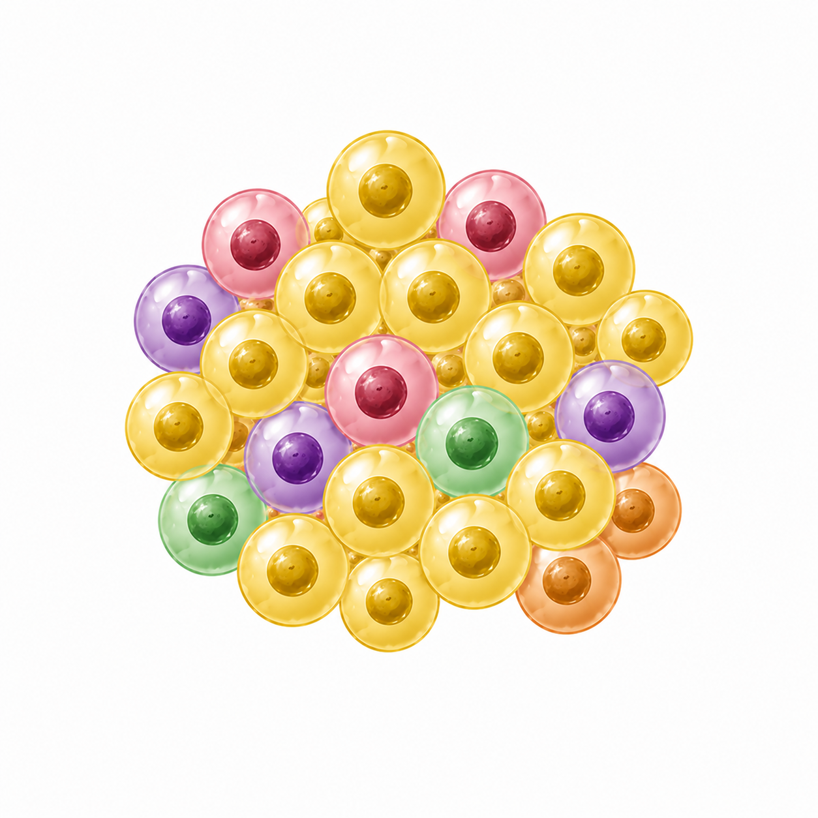
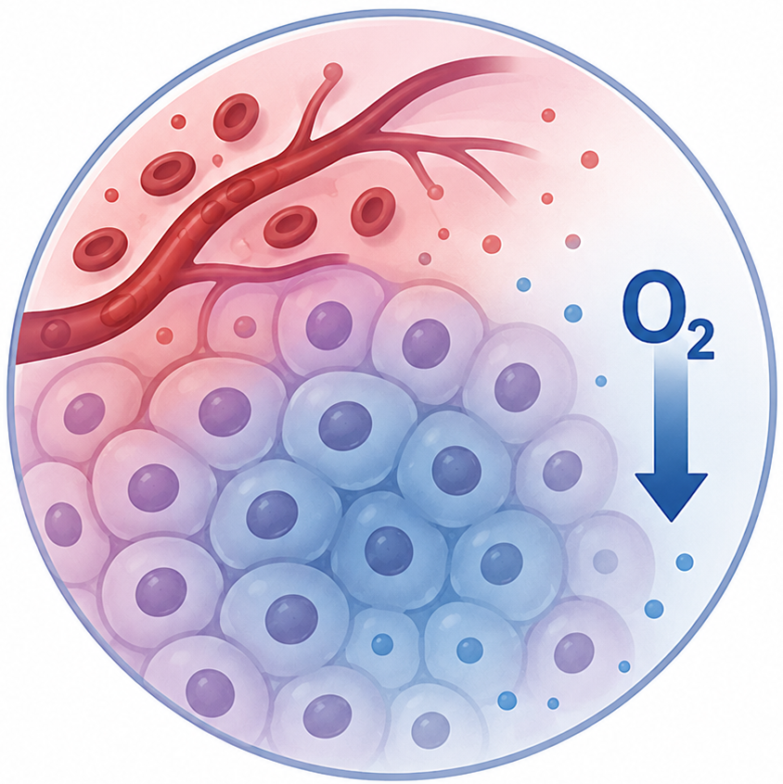


Treatment Resistance and Tumor Relapse
Why do some cells survive?
Mutation
Local tissue environment
(e.g. low oxygen)
Ineffective delivery of treatment
Immune evasion
Before treatment
Treatment effect
Regrowth
Even a few surviving cells may lead to tumor relapse.

Slide 8
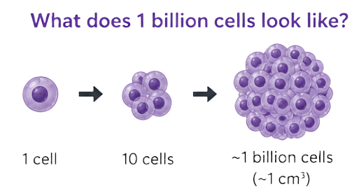
Tumor at Detection
Q.
How many cells does a tumor contain
when it is typically detected by doctors?
D. About 1 billion cells
100 cells
10,000 cells
1 million cells
1 billion cells
Which one do you think is the closest?

Slide 9
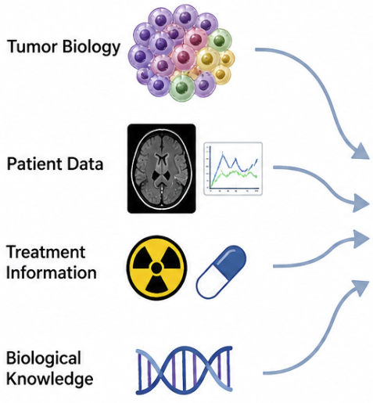
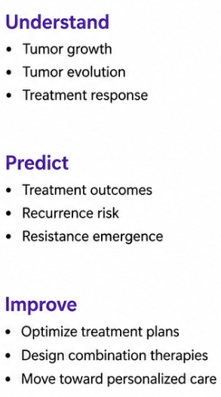

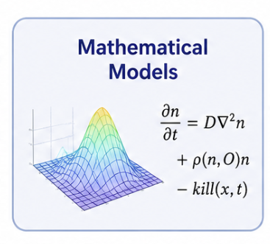

Mathematical Oncology
Notes:
This is where we need research. – Mathe allows us to perform virtual experiments that would be impossible, too expensive to explore, or too time-consuming in real patients.

Slide 10
Q&A

